Slide 1
Creating a Tough AI for Tic Tac Toe
Thomas McDonald
Daniel Rivera

Slide 2
Method 1
Daniel

Slide 3
Magic Squares
Fills matrix with values from 1 to n squared
Process differs between odd and even squares

Slide 4
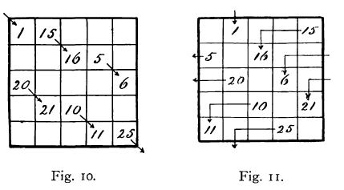
Odd Squares
Various ways how to set up one depending what rules you pick

Slide 5
My conditions
1 at (n/2, n-1) = (x, y)
Next number (x-1, y+1), if out of bound wrap around
If spot already has a number, (x+1, y-2)
If (-1, y), go to (0, y-2)

Slide 6
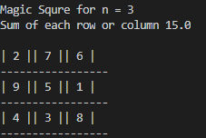
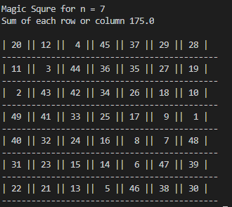
Odd Squares

Slide 7
Even Squares
Swap [n/4,n/4] matrix in the corner
Swap [n/2, n/2] matrix in the center

Slide 8
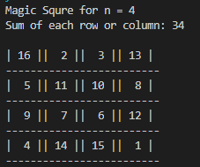
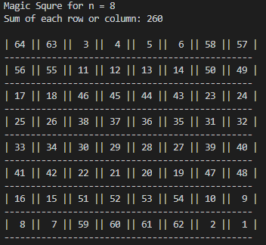
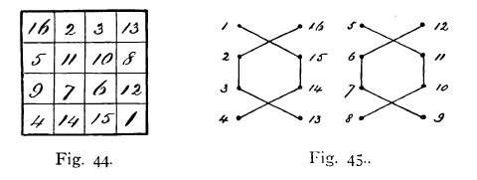

Slide 9
Tic-tac-toe with Magic Squares
Created in python
User vs AI
AI found to be beatable

Slide 10
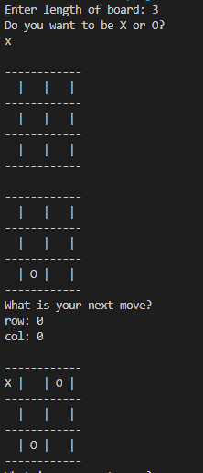
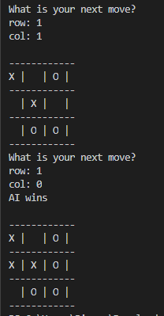
3x3 game

Slide 11
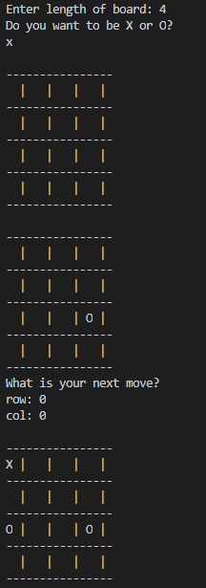
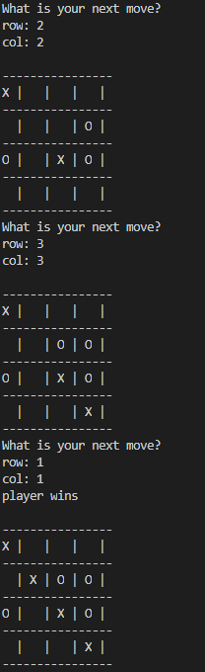
4x4 game

Slide 12
Next steps
Fix the magic algorithm for AI move for 2D
Figure how to apply magic algorithm into a 3D game

Slide 13
Method 2
Thomas McDonald

Slide 14
Why Use Minimax?
Can analyze all possible moves
Heuristics to alleviate some computation
Adaptable to most turn based games

Slide 15
Tic Tac Toe with MiniMax
Created in Python
User can play against AI
AI has proven to be Unbeatable

Slide 16
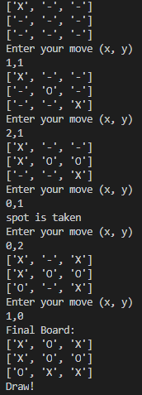
Code in Action
https://github.com/notaturkey/aiProject
https://repl.it/languages/python3

Slide 17
Observations
Implementation is fast
Quirky moves when not playing optimally
Current way of using minimax might need optimizations for 3D Tic-Tac-Toe

Slide 18
Next Steps
Implement MiniMax with 3d Tic-Tac-Toe
Make game more user friendly
Optimize Code

Slide 19
Works Cited
[1] Maurice V. Wilkes. Arithmetic on the edsac. IEEE Ann.
Hist. Comput., 19(1):13–15, January 1997.
[2] Jozsef Beck. Preface. Combinatorial Games, pages xi–xiv.
[3] Roopali Garg. Game of tic-tac-toe: Simulation using min-
max algorithm. International Journal of Advanced Re-
search in Computer Science, 8(7):1074–1077, 2017.
[4] Robert Levinson, Feng-hsiung Hsu, T. Anthony Marsland,
Jonathan Schaeffer, and David Wilkins. The role of chess
in artificial intelligence research. pages 547–552, 01 1991.
[5] Tic-tac-toe. Wolfram Demonstrations Project, 2007.

Slide 20
Works Cited
Andrews, W. S. 1960. Magic Squares. In Magic Squares and Cubes, 1-63. New York: Dover.
Arthur T. Benjamin & Kan Yasuda. 1999. Magic “Squares” Indeed!, The American Mathematical Monthly, 106:2, 152-56.
R. Bruce Mattingly. 2000. Even Order Regular Magic Squares Are Singular, The American Mathematical Monthly, 107:9, 777-782.
Yangkok Kim & Jaechil Yoo. 2008. An algorithm for constructing magic squares, Discrete Applied Mathematics, 156:14, 2804-2809.

